Slide 1


Accenture Innovation Challenge
Harness Generative AI to develop innovative solutions that boost business and societal growth

Slide 2




Team details
TEAM NAME: Career Hub
N.Sasi Preetham
A.Phani Kumar
College: Rise Krishna Sai Prakasam Group Of Institutions
Stream: Computer Science And Engineering
Year of graduation: 2025
College: Rise Krishna Sai Prakasam Group Of Institutions
Stream: Computer Science And Engineering
Year of graduation: 2025
S.Mahendra Naik
Photo
Photo
P.Praveen
College: Rise Krishna Sai Prakasam Group Of Institutions
Stream: Computer Science And Engineering
Year of graduation: 2025
College: Rise Krishna Sai Prakasam Group Of Institutions
Stream: Computer Science And Engineering
Year of graduation: 2025
All fields are mandatory

Slide 3

Problem Statement: The current state of job searching is a complex and challenging process, marked by limited job matchings and recommendations, leading to a frustrating and time-consuming experience for job seekers. Despite companies having high profiles, the hiring process often lacks transparency, making it difficult for candidates to showcase their skills and experience.
The current job searching landscape is marred by numerous inefficiencies, resulting in a poor experience for both job candidates and employers. This flawed system leads to a frustrating and time-consuming process for all parties involved.

Slide 4

Proposed Solution:
Our proposed solution is a personalized job search platform that leverages AI-powered job matching and recommendations, transparency in the hiring process, and interactive profiles to showcase skills and experience. This innovative platform aims to transform the job searching experience for both candidates and employers.

Slide 5

How does your innovation accelerate change with the power of Technology? (200 words)
Job search accelerates change in the job search process by harnessing the power of technology to transform it from a time consuming and frustrating experience to a personalized, efficient, and transparent one.
By leveraging AI powered job matching , reduce time-to hire and increasing the accuracy of job matches. Real-time updates and notifications keep candidates informed throughout the hiring process, increasing transparency and trust.
Interactive profiles allows candidates to showcase their visibility attractiveness to potential employers. Personalized career coaching and development resources, powered by machine learning algorithms, provide tailored guidance and support, accelerating career growth and development.
Personalized career coaching and a scalable infrastructure ensures a seamless experience. By harnessing technology, job search revolutionizes the empowering candidates and employers to succeed in a rapidly changing job market.

Slide 6

How is your solution different/unique from other solutions in market? (150 words)
Job search stands out from other job search platforms with its unique combination of AI-powered job matching, real-time updates, and interactive profiles. Unlike traditional job boards, it uses machine learning algorithms to match candidates with the most relevant jobs, increasing the accuracy of job matches.
Additionally, our platform provides personalized career coaching and development resources, setting us apart from other job search platforms that focus solely on job matching.
Our scalable and secure infrastructure ensures a seamless experience, making which is a comprehensive and innovative solution in the job search market. This unique blend of features sets us apart from competitors
PATENT FILED: No
Do you have a working model/prototype: No
If not, will you be able to show working prototype during finale. Yes

Slide 7
Any testimonials received?
No, we have not received any testimonials yet, as we are still in the development phase and haven’t launched our platform.
However, we are excited to participate in the “Accenture Innovation Challenge” and are confident that our solution will make a positive impact in the job search market. We are looking forward to gathering feedback and testimonials from users once we launch our platform.
Share the links/photos of the testimonials you’ve received

Slide 8
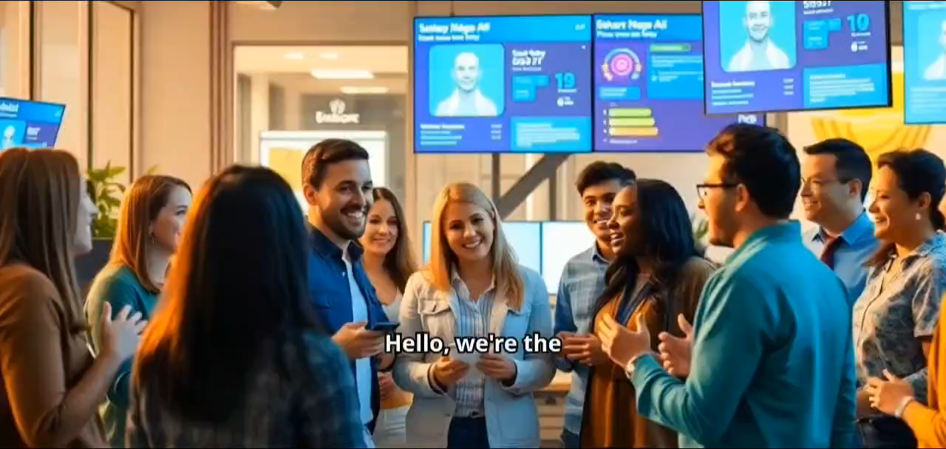
Please share a 1-minute video of your idea (embed on this PPT or add a downloadable link)

Slide 9
Thank you!

